Slide 1
Big Data

Slide 2
Aims
Where Does Big Data Come From
Open Data and Private Data
Data at Rest and Data in Motion
Evolution to Big Data
Basic Data Management Technologies

Slide 3
How many hours do you spend on your phone everyday?
Task 1
Find out how much time you spend on your mobile phone in a day and list this in your document
Android Phones:
https://www.wikihow.com/Check-Your-Total-Talk-Time-on-an-iPhone
https://android.stackexchange.com/questions/15545/how-to-find-how-many-hours-an-android-phone-has-been-used
Apple users: Screen time
Notes:
Use the links to show learners how they can find Task 2 INFORMATION

Slide 4
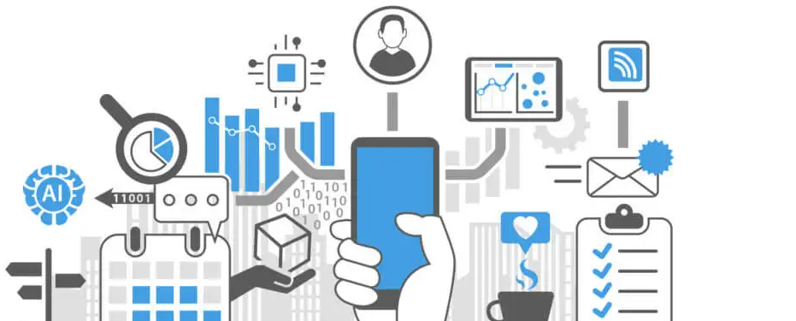
Warm up Exercise 'Discussion'
How Much Data Do We Create Every Day?
More than 3.7 billion humans use the internet (that’s a growth rate of 7.5 percent over 2016).
On average, Google now processes more than 40,000 searches EVERY second (3.5 billion searches per day)!
While 77% of searches are conducted on Google and other search engines are also contributing to our daily data generation.
Worldwide there are 5 billion searches a day.
Notes:
Think about the above statement. Give 5 mins to talk about this question
The amount of data we produce every day is truly mind-boggling. There are 2.5 quintillion bytes of data created each day at our current pace, but that pace is only accelerating with the growth of the Internet of Things (IoT).

Slide 5
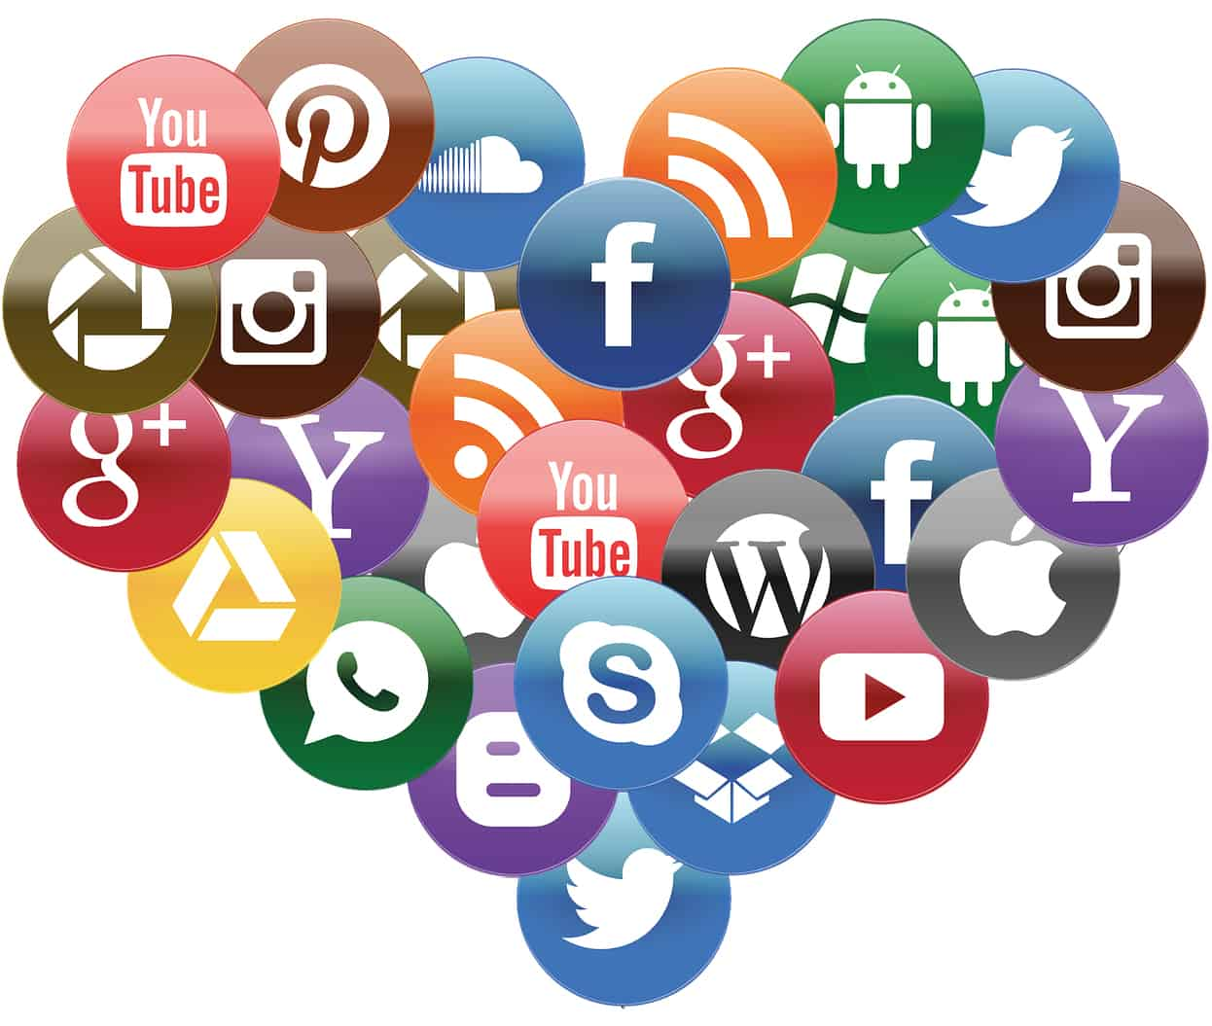
Where Does Big Data Come From
A significant part of big data is generated from three primary resources:
Machine data
Social data,
Transactional data.
Payment orders
Invoices
Storage records and
E-receipts
Notes:
Machine Data
Machine data is automatically generated, either as a response to a specific event or a fixed schedule. It means all the information is developed from multiple sources such as smart sensors, SIEM logs, medical devices and wearables, road cameras, IoT devices, satellites, desktops, mobile phones, industrial machinery, etc. These sources enable companies to track consumer behaviour.
Social Data
It is derived from social media platforms through tweets, retweets, likes, video uploads, and comments shared on Facebook, Instagram, Twitter, YouTube, Linked In etc. The extensive data generated through social media platforms and online channels offer qualitative and quantitative insights on each crucial facet of brand-customer interaction. So It gauges important insights regarding customer behaviour, their sentiment regarding products and services. This is why brands capitalising on social media channels can build a strong connection with their online demographic. Businesses can harness this data to understand their target market and customer base. This inevitably enhances their decision-making process.
Transactional Data
transactional data is information gathered via online and offline transactions during different points of sale. The data includes vital details like transaction time, location, products purchased, product prices, payment methods, discounts/coupons used, and other relevant quantifiable information related to transactions.
The sources of transactional data include:
Payment orders
Invoices
Storage records and
E-receipts

Slide 6
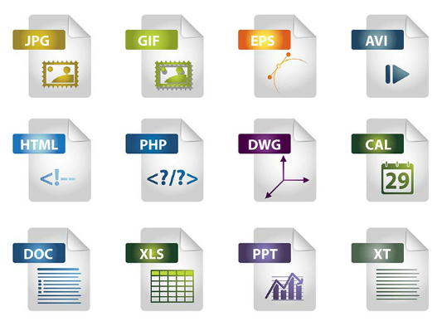
Data Acquisition and Preparation Sources of Data
There are many different sources of data.
A vast amount of historical data can be found in files such as:
MS Word documents
Emails
Spreadsheets
MS PowerPoints
PDFs
HTML
and plaintext files
Public and Private Archives
CSV, JSON, and XML files use plaintext, a common format, and are compatible with a wide range of applications
The Web can be mined for data using a web scraping application

Slide 7
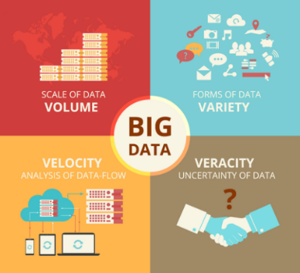

Defining Big Data
Defining Big Data
Data that is so vast, fast, or complex that it becomes impossible to store, process, and analyze using traditional data storage and analytics applications
Big Data Characteristics
4 big Vs of Big Data: volume, velocity, variety, and veracity
Volume – amount of data
Velocity – rate data is generated
Variety – type of data
Veracity – preventing inaccurate data from spoiling a data set
How much Data is Big Data
IBM’s Paul Zikopaulos stated it takes 200 to 600 Terabytes to qualify as Big Data
https://www.ibm.com/blogs/systems/author/paulzikopoulos/
Notes:
Paul Zikopaulos Vice President of Cognitive BigData Systems at IBM

Slide 8
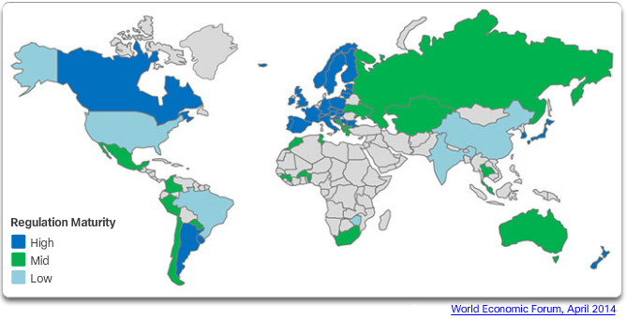
Open Data and Private Data
Open Data
The Open Knowledge Foundation describes Open Data as “any content, information or data that people are free to use, reuse, and redistribute without any legal, technological, or social restriction.”
Private Data
Data related to an expectation of privacy and regulated by a particular country/government

Slide 9
Some examples of how big data helps companies are:
Assisting companies to refine their advertising and marketing strategies/campaigns.
Improve their consumer engagement and lead conversion rates.
It helps to study the changing behaviour of corporate buyers, customers and the market.
Become more responsive to the market and customers needs.

Slide 10
Big Data Recap Questions
What do you know about the term “Big Data”?
What are 4 Vs of big data ?

Slide 11
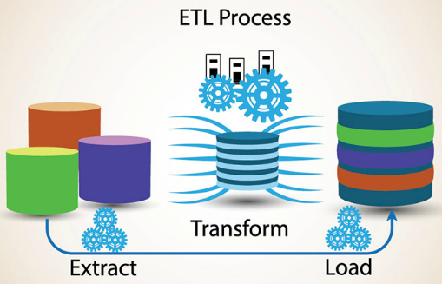
Data Acquisition and Preparation Data Preparation
Collected data may not be compatible or formatted correctly
Data must be prepared before it can be added to a data set
Extract, Transform and Load (ETL)
process for collecting data from a variety of sources, transforming the data, and then loading the data into a database

Slide 12
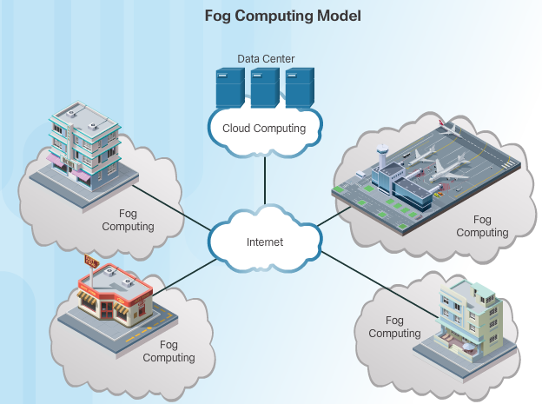
Data at Rest and Data in Motion
Data at Rest
Data stored in a physical location such as a server hard drive or within a data center
Follows the traditional data analysis flow of Store > Analyze > Notify > Act
Data in Motion
Dynamic data that requires real-time processing before the data becomes irrelevant or obsolete
Analysis and action happen sooner rather than later
Data analysis flow is Analyze > Act > Notify > Store

Slide 13
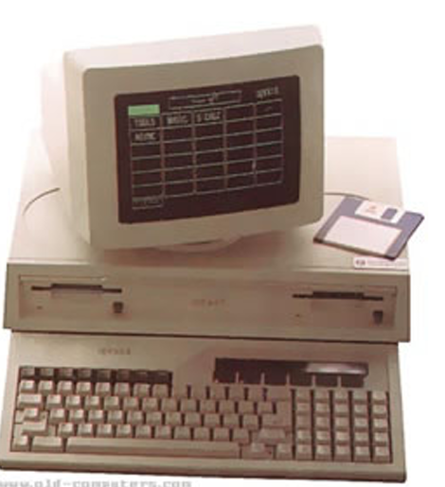
Evolution to Big Data

Slide 14
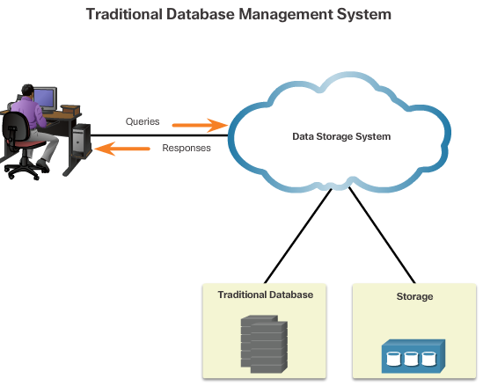
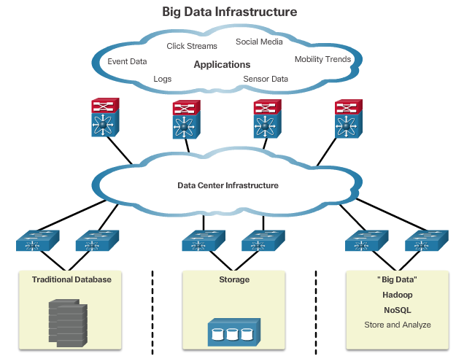
Evolution to Big Data
Traditional to Big Data Infrastructure
Database servers and traditional data processing tools
Distributed data systems across horizontally coupled, independent resources to achieve the scalability needed for the efficient processing of extensive data sets
Onsite and cloud computing solutions

Slide 15
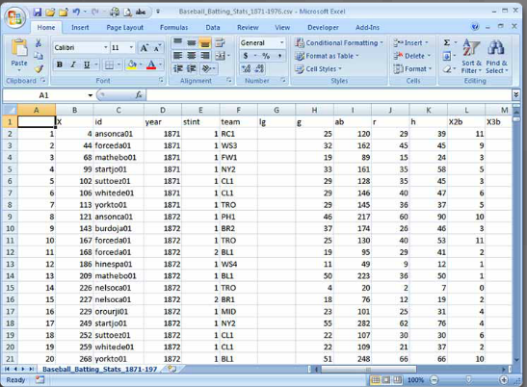
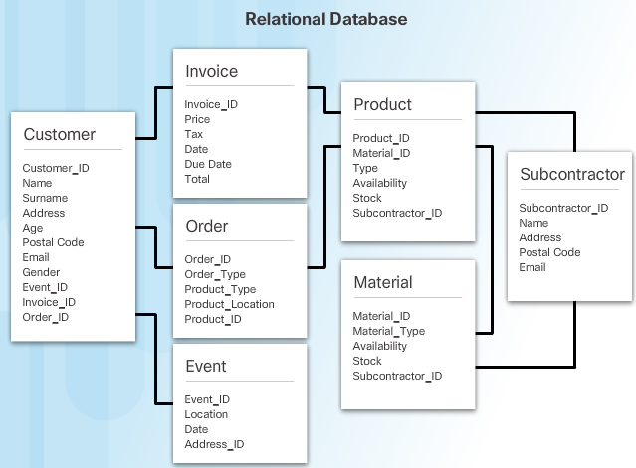
Basic Data Management Technologies
Flat file database – stores records in a single file with no hierarchical structure such as a spreadsheet
Relational database – capture relationships between different sets of data, creating more useful information

Slide 16

Basic Data Management Technologies
Relational Database Management System is the dominant database technology with no challenge for over 30 years.
Big Data analytics becomes increasingly difficult to manage with a relational database management system (RDBMS)
NoSQL database structure created to make database design simpler with faster. Meets the demands of Web applications.
Notes:
We have leant about these previously in data

Slide 17
Recap Questions
What is ETL?
What is ETL used for ?

